Slide 1

JS Outside the Browser
Intro to NodeJS

Slide 2

Javascript runtime outside of the browser
Native event-driven flow
Concurrent processes (no blocking)

Slide 3
NodeJS Uses
Webservers
Automated Tests
Build Scripts (Transpiling)
And More!

Slide 4
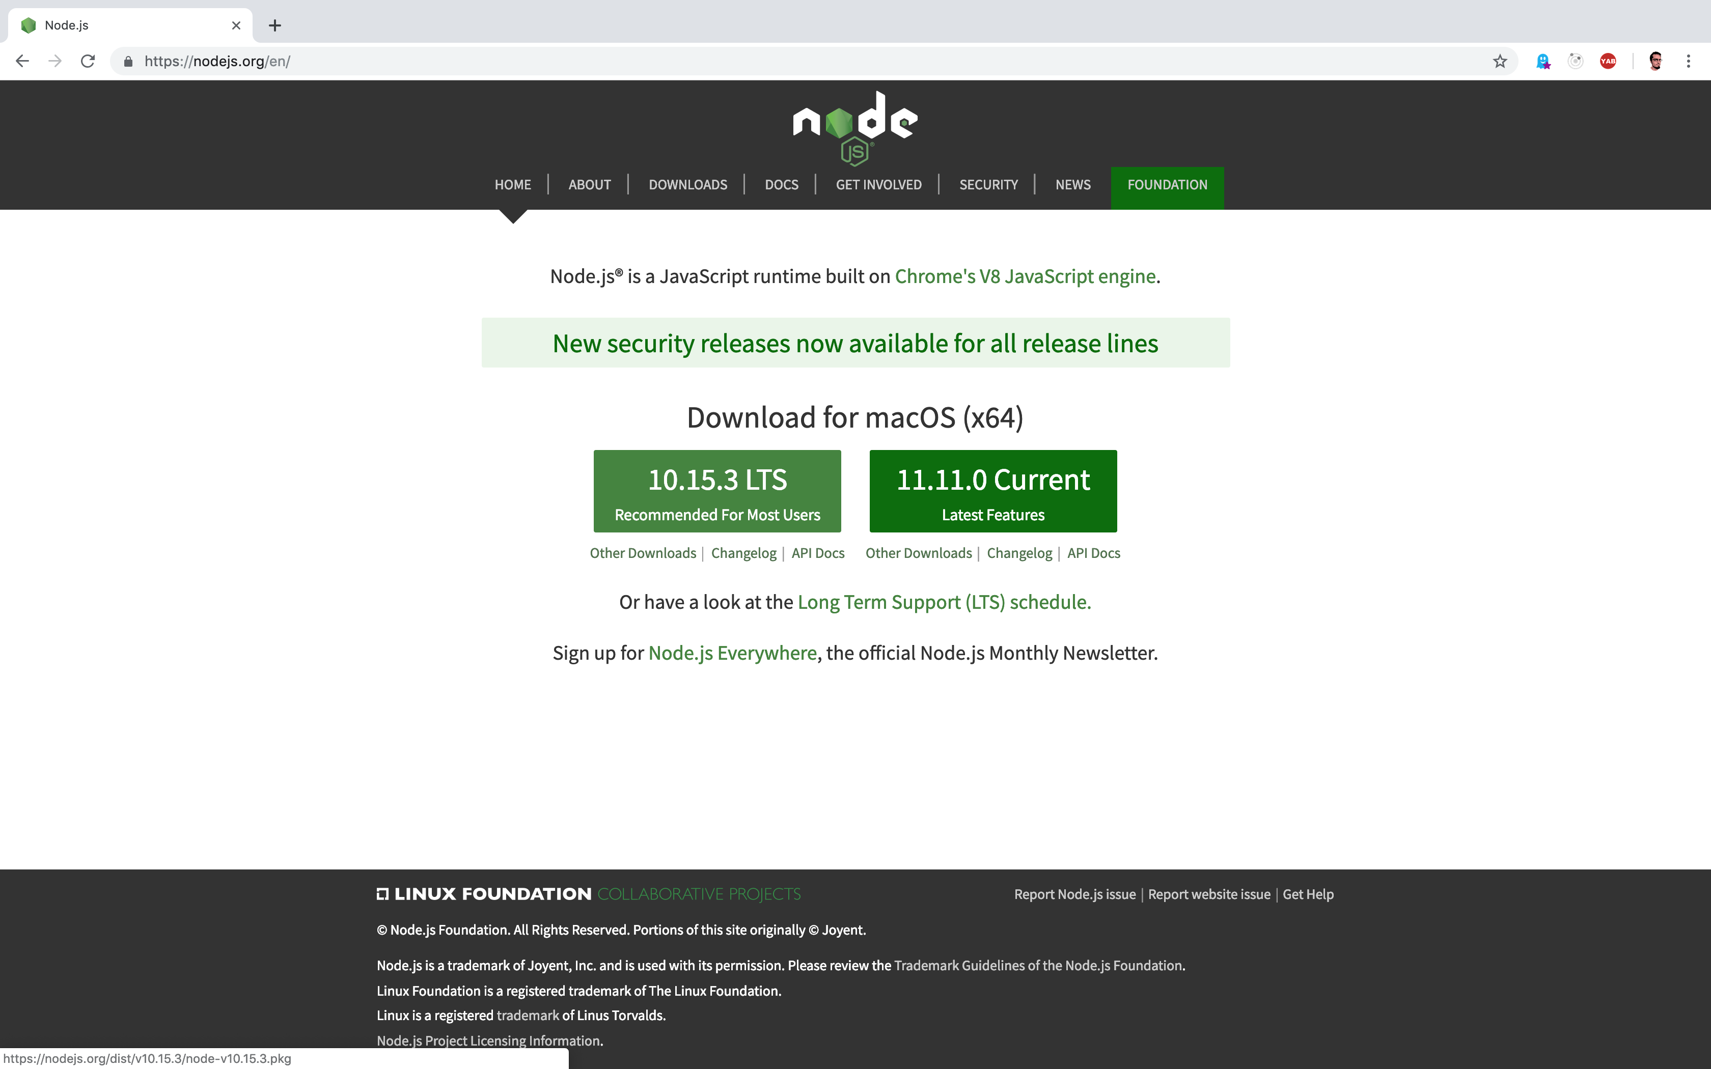

Slide 5
